Slide 1
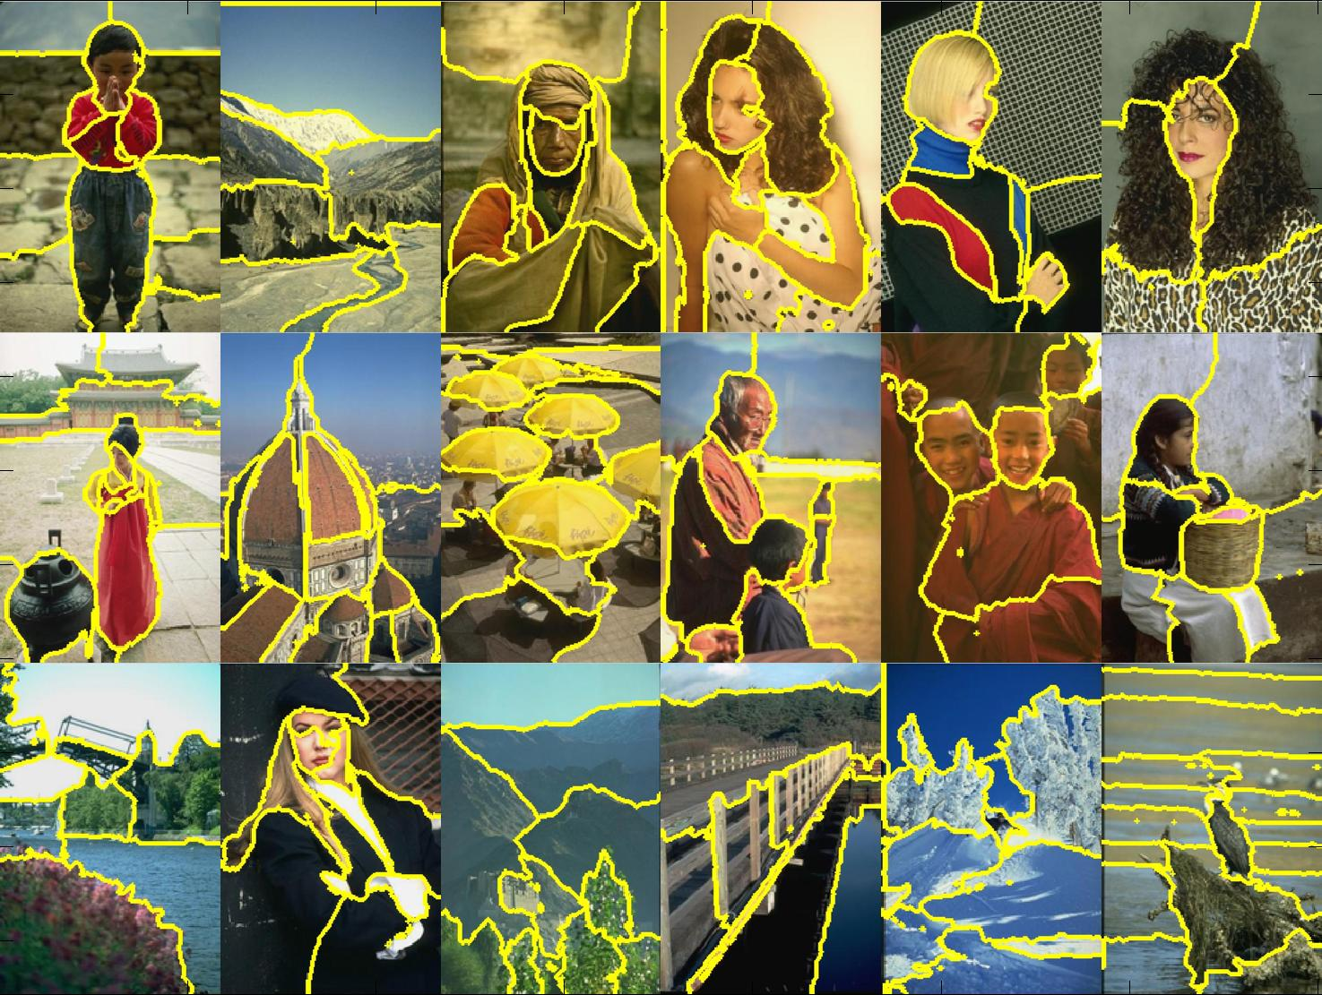
Segmentation & Custering
Thursday, October 11th 2018
Peter Anderson
Georgia Tech
Disclaimer: Many slides have been borrowed from Kristen Grauman, who may have borrowed some of them from others. Any time a slide did not already have a credit on it, I have credited it to Kristen. So there is a chance some of these credits are inaccurate.
Slide credit: Kristen Grauman
Notes:
1

Slide 2
Topics overview
Intro
Multiple views and motion
Features & filters
Grouping & fitting
Segmentation and clustering
Hough transform
Deformable contours
Recognition
Video processing
Slide credit: Kristen Grauman

Slide 3
Outline
What are grouping/clustering problems in vision?
Inspiration from human perception
Gestalt properties
Bottom-up segmentation via clustering
Algorithms:
Mode finding and mean shift: k-means, mean-shift
Graph-based: normalized cuts
Features: color, texture, …
Quantization for texture summaries
Slide credit: Kristen Grauman
Notes:
3

Slide 4
Grouping in vision
Goals:
Gather features that belong together
Obtain an intermediate representation that compactly describes key image or video parts
Slide credit: Kristen Grauman

Slide 5
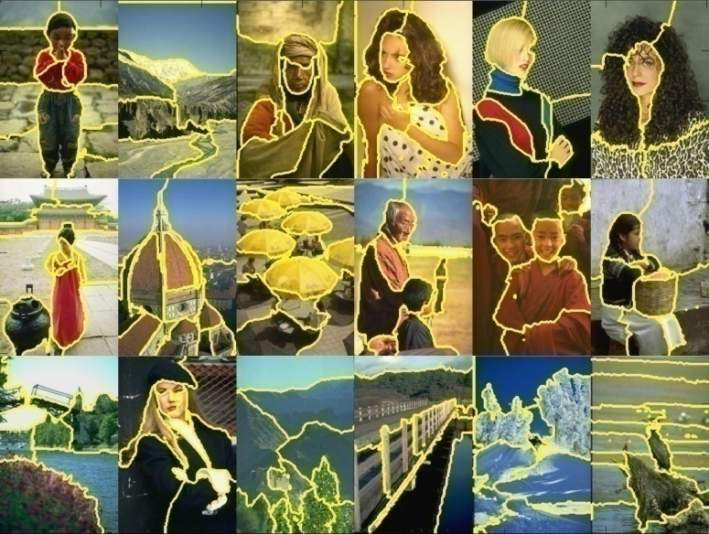
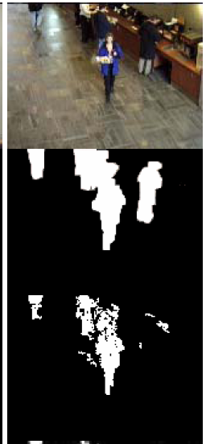
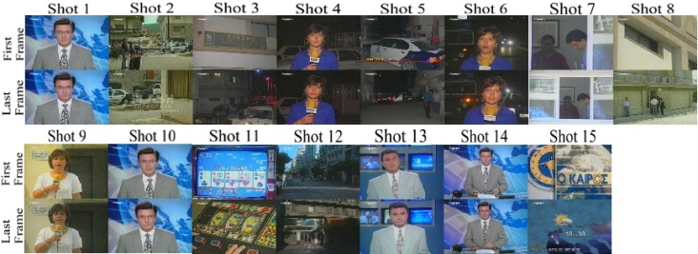
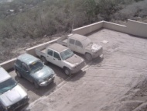
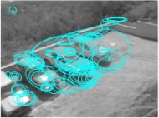
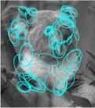
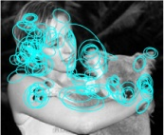

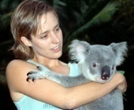
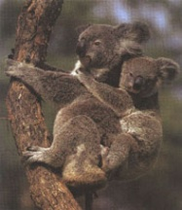
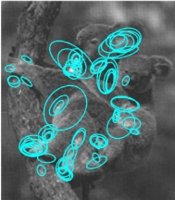
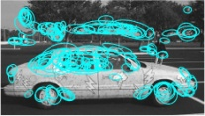

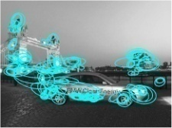



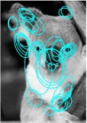
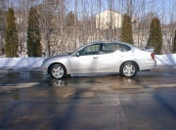
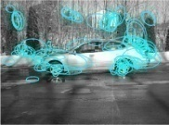

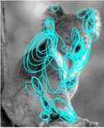
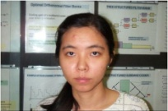
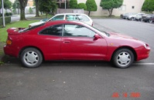
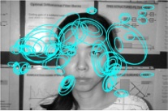
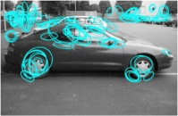
Examples of grouping in vision
[http://poseidon.csd.auth.gr/LAB_RESEARCH/Latest/imgs/SpeakDepVidIndex_img2.jpg]
Group video frames into shots
[Figure by J. Shi]
Determine image regions
Fg / Bg
[Figure by Wang & Suter]
Figure-ground
[Figure by Grauman & Darrell]
Object-level grouping
Slide credit: Kristen Grauman
Notes:
5

Slide 6
Grouping in vision
Goals:
Gather features that belong together
Obtain an intermediate representation that compactly describes key image (video) parts
Top down vs. bottom up segmentation
Top down: pixels belong together because they are from the same object
Bottom up: pixels belong together because they look similar
Hard to measure success
What is interesting depends on the application.
Slide credit: Kristen Grauman

Slide 7
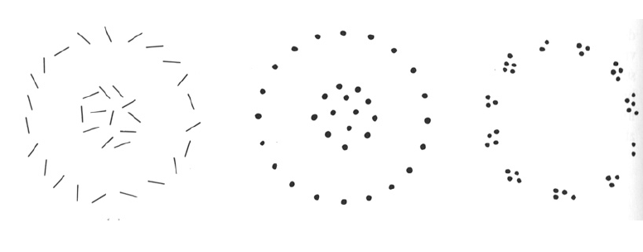
Slide credit: Kristen Grauman

Slide 8
Gestalt
A key feature of the human visual system is that context affects how things are perceived
Gestalt: whole or group
Whole is something other than sum of its parts
Relationships among parts can yield new properties/features
Slide credit: Kristen Grauman
Notes:
8

Slide 9
Example: Muller-Lyer illusion
Notes:
9

Slide 10
Example: Muller-Lyer illusion
Notes:
10

Slide 11
Example: Muller-Lyer illusion
The effect only arises because we perceive each shape as something other than the sum of it’s parts…
What things should be grouped? What cues indicate groups?
Notes:
11

Slide 12
Gestalt
Gestalt: whole or group
Whole is something other than sum of its parts
Relationships among parts can yield new properties/features
Psychologists identified series of factors that predispose set of elements to be grouped (by human visual system)
Slide credit: Kristen Grauman
Notes:
12

Slide 13
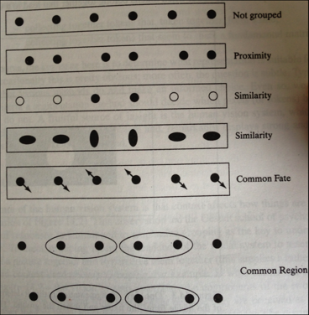
Gestalt
Figure 14.4 from Forsyth and Ponce
Slide credit: Devi Parikh

Slide 14
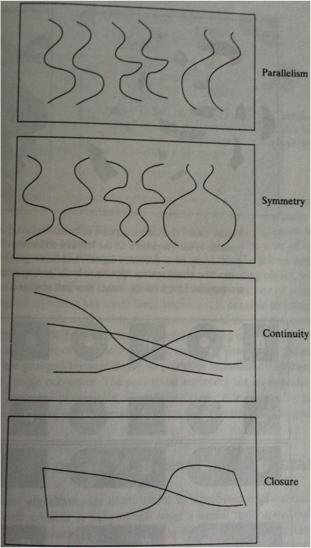
Gestalt
Slide credit: Devi Parikh

Slide 15
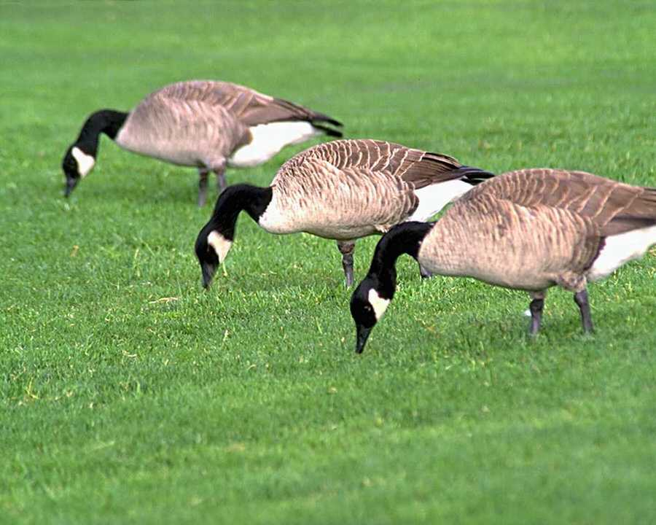
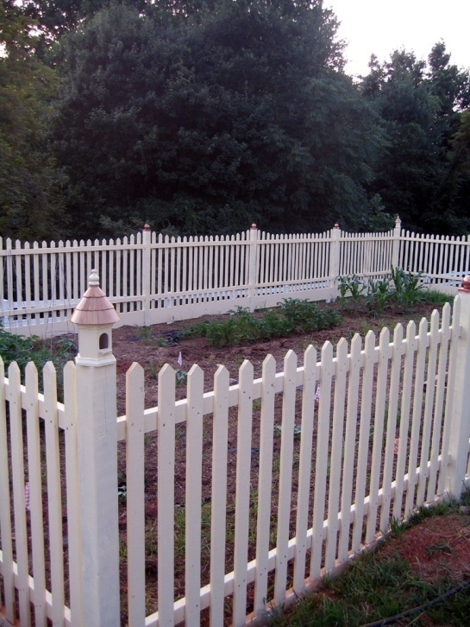
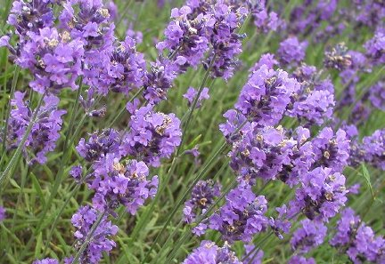
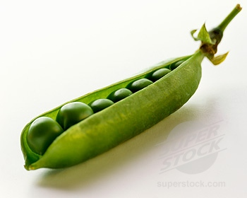
Similarity
Kristen Grauman
http://chicagoist.com/attachments/chicagoist_alicia/GEESE.jpg, http://wwwdelivery.superstock.com/WI/223/1532/PreviewComp/SuperStock_1532R-0831.jpg

Slide 16
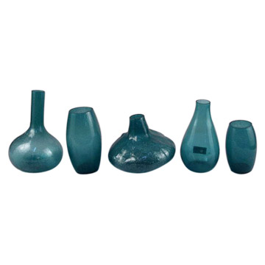
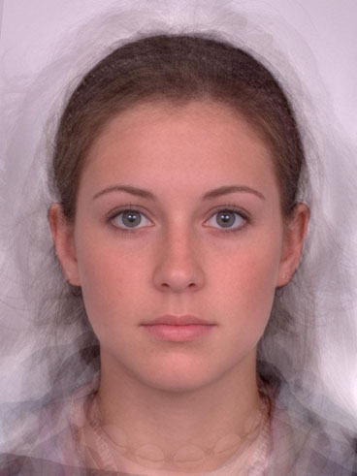
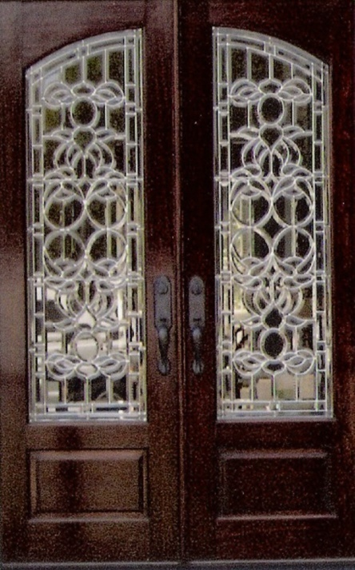
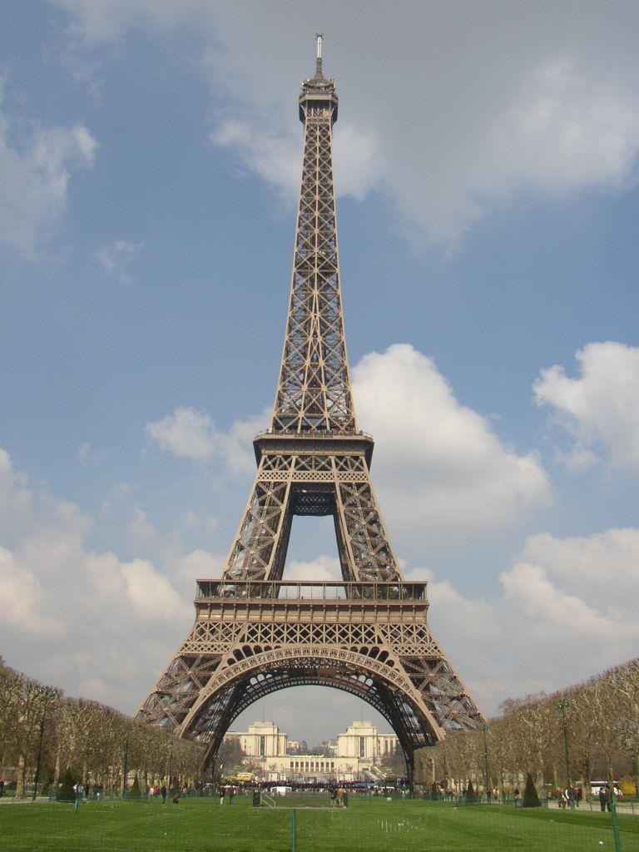
Symmetry
Slide credit: Kristen Grauman
http://seedmagazine.com/news/2006/10/beauty_is_in_the_processingtim.php

Slide 17
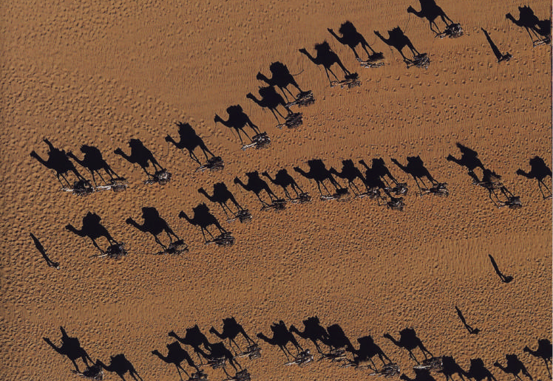
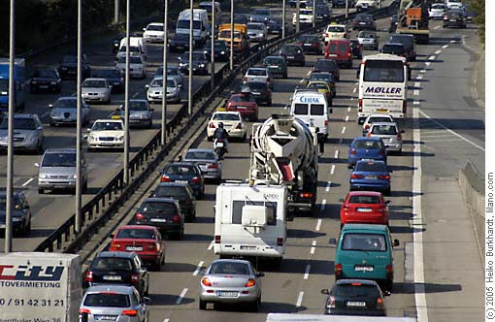
Common fate
Image credit: Arthus-Bertrand (via F. Durand)
(coherent motion)
Slide credit: Kristen Grauman

Slide 18
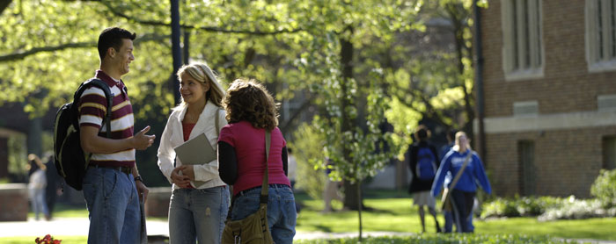
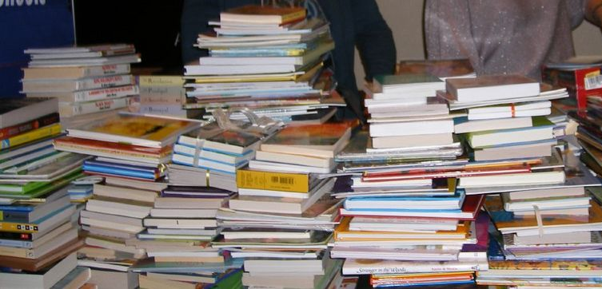
Proximity
Slide credit: Kristen Grauman
http://www.capital.edu/Resources/Images/outside6_035.jpg

Slide 19
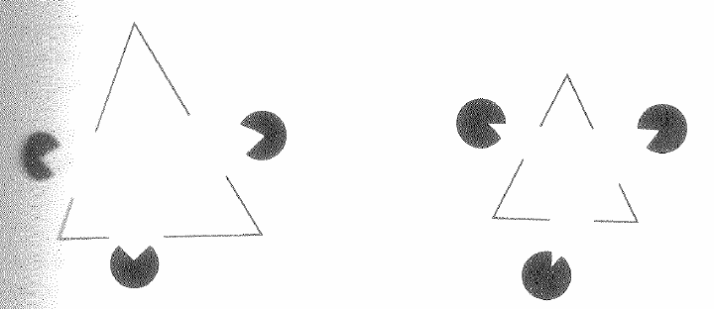
Illusory/subjective contours
Interesting tendency to explain by occlusion
Slide credit: Kristen Grauman
In Vision, D. Marr, 1982
Notes:
19

Slide 20
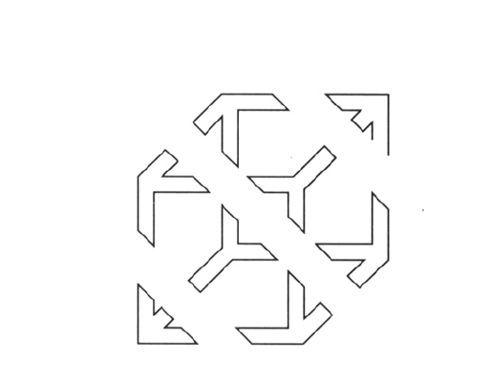
Slide credit: Kristen Grauman

Slide 21
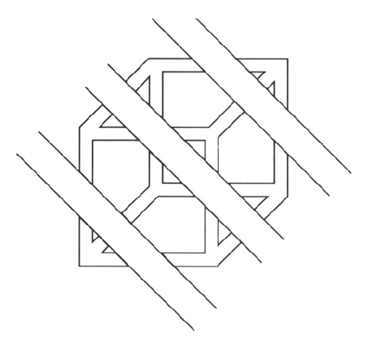
Continuity, explanation by occlusion
Slide credit: Kristen Grauman

Slide 22
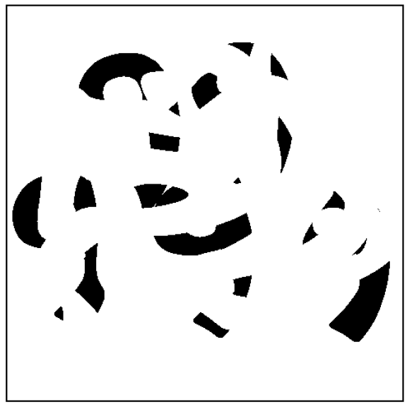
D. Forsyth

Slide 23
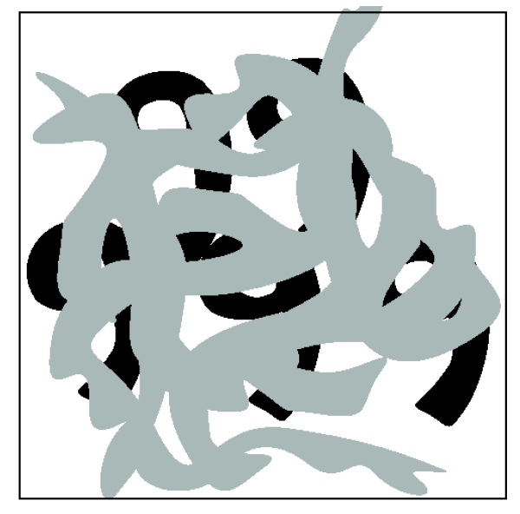
Slide credit: Kristen Grauman

Slide 24
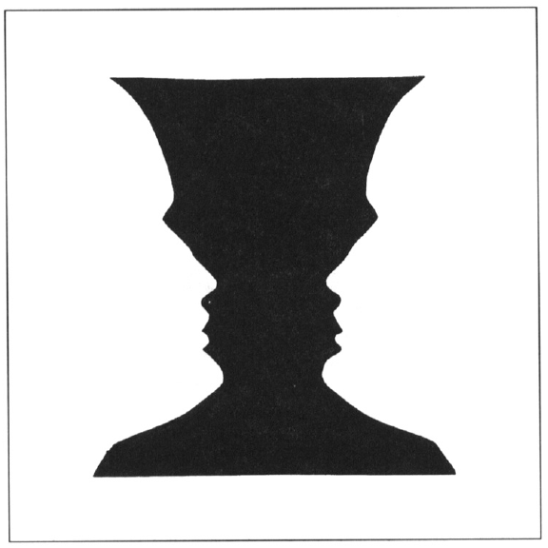
Figure-ground
Slide credit: Kristen Grauman

Slide 25
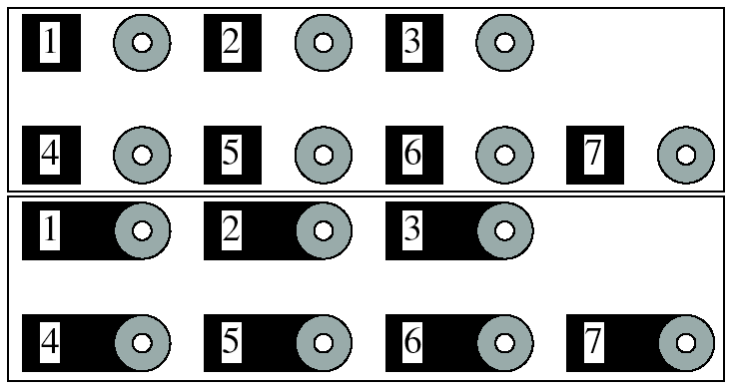
Grouping phenomena in real life
Forsyth & Ponce, Figure 14.7
Slide credit: Kristen Grauman

Slide 26
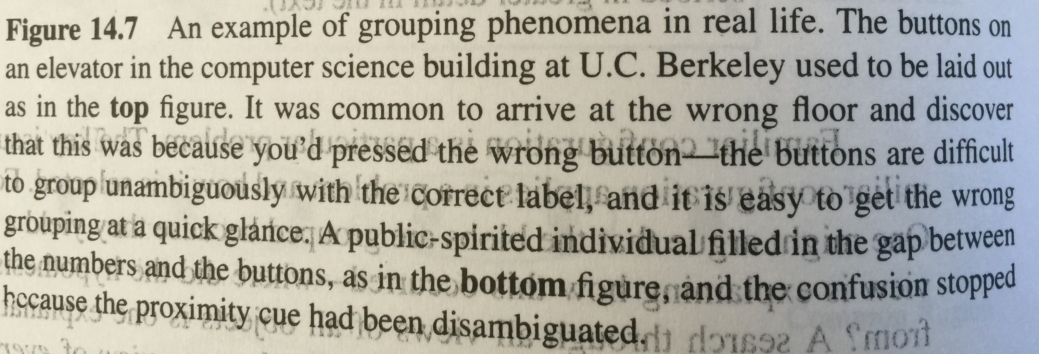
Grouping phenomena in real life
Forsyth & Ponce, Figure 14.7
Slide credit: Kristen Grauman

Slide 27
Grouping phenomena in real life
Forsyth & Ponce, Figure 14.7
Slide credit: Kristen Grauman

Slide 28
Gestalt
Gestalt: whole or group
Whole is other than sum of its parts
Relationships among parts can yield new properties/features
Psychologists identified series of factors that predispose set of elements to be grouped (by human visual system)
Inspiring observations/explanations; challenge remains how to best map to algorithms.
Slide credit: Kristen Grauman
Notes:
28

Slide 29
Outline
What are grouping problems in vision?
Inspiration from human perception
Gestalt properties
Bottom-up segmentation via clustering
Algorithms:
Mode finding and mean shift: k-means, mean-shift
Graph-based: normalized cuts
Features: color, texture, …
Quantization for texture summaries
Slide credit: Kristen Grauman
Notes:
29

Slide 30
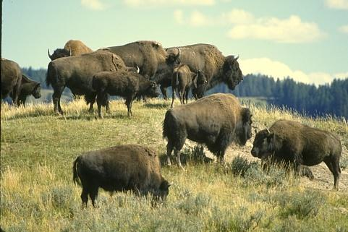
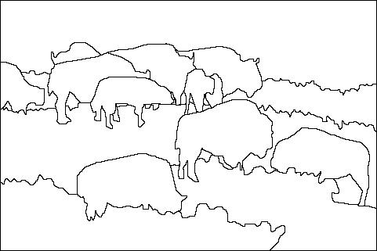
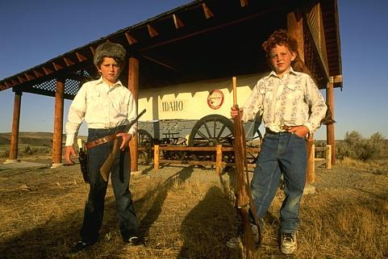
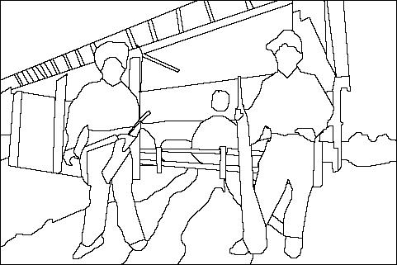
The goals of segmentation
Separate image into coherent “objects”
image
human segmentation
Source: Lana Lazebnik

Slide 31
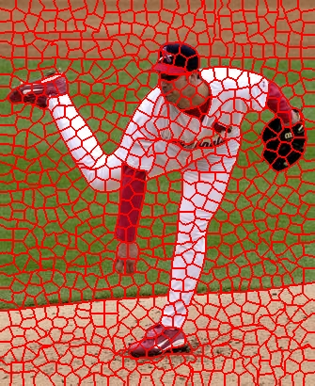
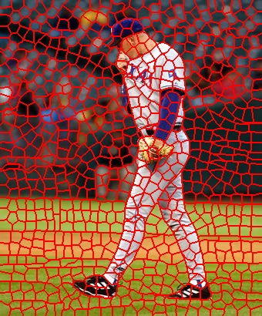
The goals of segmentation
Separate image into coherent “objects”
Group together similar-looking pixels for efficiency of further processing
“superpixels”
X. Ren and J. Malik. Learning a classification model for segmentation. ICCV 2003.
Source: Lana Lazebnik

Slide 32


Image segmentation: toy example
white pixels
pixel count
3
black pixels
gray pixels
1
2
input image
intensity
These intensities define the three groups.
We could label every pixel in the image according to which of these primary intensities it is.
i.e., segment the image based on the intensity feature.
What if the image isn’t quite so simple?
Kristen Grauman

Slide 33


pixel count
input image
intensity
pixel count
input image
intensity
Kristen Grauman

Slide 34
pixel count
input image
intensity
Now how to determine the three main intensities that define our groups?
We need to cluster.
Kristen Grauman

Slide 35

0
190
255
intensity
3
1
2
Goal: choose three “centers” as the representative intensities, and label every pixel according to which of these centers it is nearest to.
Best cluster centers are those that minimize SSD between all points and their nearest cluster center ci:
Kristen Grauman

Slide 36
Clustering
With this objective, it is a “chicken and egg” problem:
If we knew the cluster centers, we could allocate points to groups by assigning each to its closest center.
If we knew the group memberships, we could get the centers by computing the mean per group.
Kristen Grauman

Slide 37
K-means clustering
Basic idea: randomly initialize the k cluster centers, and iterate between the two steps we just saw.
Randomly initialize the cluster centers, c₁, ..., c_{K}
Given cluster centers, determine points in each cluster
For each point p, find the closest c_{i}. Put p into cluster i
Given points in each cluster, solve for c_{i}
Set c_{i} to be the mean of points in cluster i
If c_{i} have changed, repeat Step 2
Properties
Will always converge to some solution
Can be a “local minimum”
does not always find the global minimum of objective function:
Source: Steve Seitz

Slide 38

Andrew Moore

Slide 39

Andrew Moore

Slide 40

Andrew Moore

Slide 41

Andrew Moore

Slide 42

Andrew Moore

Slide 43
K-means clustering
Demo
http://stanford.edu/class/ee103/visualizations/kmeans/kmeans.html
Slide credit: Kristen Grauman

Slide 44


K-means: pros and cons
Pros
Simple, fast to compute
Converges to local minimum of within-cluster squared error
Cons/issues
Setting k?
Sensitive to initial centers
Sensitive to outliers
Detects spherical clusters
Assuming means can be computed
Slide credit: Kristen Grauman
Notes:
44

Slide 45

An aside: Smoothing out cluster assignments
Assigning a cluster label per pixel may yield outliers:
original
labeled by cluster center’s intensity
?
How to ensure they are spatially smooth?
3
1
2
Kristen Grauman

Slide 46

Segmentation as clustering
Depending on what we choose as the feature space, we can group pixels in different ways.
Grouping pixels based on intensity similarity
Feature space: intensity value (1-d)
Slide credit: Kristen Grauman
Notes:
46

Slide 47


K=2
K=3
quantization of the feature space; segmentation label map
Slide credit: Kristen Grauman

Slide 48

Segmentation as clustering
Depending on what we choose as the feature space, we can group pixels in different ways.
R=255
G=200
B=250
Grouping pixels based on color similarity
B
R=245
G=220
B=248
G
R=15
G=189
B=2
R=3
G=12
B=2
R
Feature space: color value (3-d)
Kristen Grauman
Notes:
48

Slide 49
Segmentation as clustering
Depending on what we choose as the feature space, we can group pixels in different ways.
Grouping pixels based on intensity similarity
Clusters based on intensity similarity don’t have to be spatially coherent.
Kristen Grauman
Notes:
49

Slide 50
Segmentation as clustering
Depending on what we choose as the feature space, we can group pixels in different ways.
Grouping pixels based on intensity+position similarity
Intensity
Y
X
Both regions are black, but if we also include position (x,y), then we could group the two into distinct segments; way to encode both similarity & proximity.
Kristen Grauman
Notes:
50

Slide 51



Segmentation as clustering
Color, brightness, position alone are not enough to distinguish all regions…
Slide credit: Kristen Grauman

Slide 52

Segmentation as clustering
Depending on what we choose as the feature space, we can group pixels in different ways.
Grouping pixels based on texture similarity
F₁
F₂
Filter bank of 24 filters
…
F₂₄
Feature space: filter bank responses (e.g., 24-d)
Slide credit: Kristen Grauman
Notes:
52

Slide 53

Recall: texture representation example
Windows with primarily horizontal edges
Both
 | mean d/dx value | mean d/dy value
Win. #1 | 4 | 10
Win.#2 | 18 | 7
Win.#9 | 20 | 20
Dimension 2 (mean d/dy value)
Dimension 1 (mean d/dx value)
…
…
Windows with small gradient in both directions
Windows with primarily vertical edges
statistics to summarize patterns in small windows
Kristen Grauman
Notes:
53

Slide 54


Segmentation with texture features
Find “textons” by clustering vectors of filter bank outputs
Describe texture in a window based on texton histogram
Count
Image
Texton map
Texton index
Count
Count
Texton index
Texton index
Malik, Belongie, Leung and Shi. IJCV 2001.
Adapted from Lana Lazebnik

Slide 55

Image segmentation example
Kristen Grauman

Slide 56


Pixel properties vs. neighborhood properties
These look very similar in terms of their color distributions (histograms).
How would their texture distributions compare?
Kristen Grauman

Slide 57
Outline
What are grouping problems in vision?
Inspiration from human perception
Gestalt properties
Bottom-up segmentation via clustering
Algorithms:
Mode finding and mean shift: k-means, mean-shift
Graph-based: normalized cuts
Features: color, texture, …
Quantization for texture summaries
Slide credit: Kristen Grauman
Notes:
57

Slide 58
K-means: pros and cons
Pros
Simple, fast to compute
Converges to local minimum of within-cluster squared error
Cons/issues
Setting k?
Sensitive to initial centers
Sensitive to outliers
Detects spherical clusters
Assuming means can be computed
Slide credit: Kristen Grauman
Notes:
58

Slide 59

Mean shift algorithm
The mean shift algorithm seeks modes or local maxima of density in the feature space
Feature space
(L*u*v* color values)
image
Slide credit: Kristen Grauman

Slide 60
Mean shift
Search window
Center of
mass
Mean Shift
vector
Slide by Y. Ukrainitz & B. Sarel

Slide 61
Mean shift
Search window
Center of
mass
Mean Shift
vector
Slide by Y. Ukrainitz & B. Sarel

Slide 62
Mean shift
Search window
Center of
mass
Mean Shift
vector
Slide by Y. Ukrainitz & B. Sarel

Slide 63
Mean shift
Search window
Center of
mass
Mean Shift
vector
Slide by Y. Ukrainitz & B. Sarel

Slide 64
Mean shift
Search window
Center of
mass
Mean Shift
vector
Slide by Y. Ukrainitz & B. Sarel

Slide 65
Mean shift
Search window
Center of
mass
Mean Shift
vector
Slide by Y. Ukrainitz & B. Sarel

Slide 66
Mean shift
Search window
Center of
mass
Slide by Y. Ukrainitz & B. Sarel

Slide 67

Mean shift clustering
Cluster: all data points in the attraction basin of a mode
Attraction basin: the region for which all trajectories lead to the same mode
Slide by Y. Ukrainitz & B. Sarel

Slide 68

Mean shift clustering/segmentation
Find features (color, gradients, texture, etc)
Initialize windows at individual feature points
Perform mean shift for each window until convergence
Merge windows that end up near the same “peak” or mode
Slide credit: Kristen Grauman

Slide 69




Mean shift segmentation results
http://www.caip.rutgers.edu/~comanici/MSPAMI/msPamiResults.html
Slide credit: Kristen Grauman

Slide 70

Mean shift segmentation results
Slide credit: Kristen Grauman

Slide 71
Mean shift
Pros:
Does not assume shape on clusters
One parameter choice (window size)
Generic technique
Find multiple modes
Cons:
Selection of window size
Does not scale well with dimension of feature space
Kristen Grauman

Slide 72
Outline
What are grouping problems in vision?
Inspiration from human perception
Gestalt properties
Bottom-up segmentation via clustering
Algorithms:
Mode finding and mean shift: k-means, mean-shift
Graph-based: normalized cuts
Features: color, texture, …
Quantization for texture summaries
Slide credit: Kristen Grauman
Notes:
72

Slide 73

Images as graphs
q
w_{pq}
w
p
Fully-connected graph
node (vertex) for every pixel
link between every pair of pixels, p,q
affinity weight w_{pq} for each link (edge)
w_{pq} measures similarity
similarity is inversely proportional to difference (in color and position…)
Source: Steve Seitz

Slide 74


Measuring affinity
One possibility:
Small sigma: group only nearby points
Large sigma: group distant points
Kristen Grauman

Slide 75

Example: weighted graphs
Suppose we have a 4-pixel image
(i.e., a 2 x 2 matrix)
Each pixel described by 2 features
Feature dimension 2
Feature dimension 1
Dimension of data points : d = 2
Number of data points : N = 4
Kristen Grauman

Slide 76


Example: weighted graphs
Computing the distance matrix:
D(:,1)=
0.01
D(1,:)=
(0)
0.24
0.01
0.47
0.24
0.47
for i=1:N
for j=1:N
D(i,j) = ||x_{i}- x_{j}||²
end
end
Kristen Grauman

Slide 77

Example: weighted graphs
Computing the distance matrix:
D(:,1)=
D(1,:)=
(0)
0.24
0.01
0.47
0.29
0.24
(0)
0.29
0.15
0.24
0.15
for i=1:N
for j=1:N
D(i,j) = ||x_{i}- x_{j}||²
end
end
Kristen Grauman

Slide 78

Example: weighted graphs
Computing the distance matrix:
for i=1:N
for j=1:N
D(i,j) = ||x_{i}- x_{j}||²
end
end
N x N matrix
Kristen Grauman

Slide 79

Distances→affinities
Example: weighted graphs
D
A
for i=1:N
for j=i+1:N
A(i,j) = exp(-1/(2*σ^2)*||x_{i}- x_{j}||²);
A(j,i) = A(i,j);
end
end
for i=1:N
for j=1:N
D(i,j) = ||x_{i}- x_{j}||²
end
end
Kristen Grauman

Slide 80



Scale parameter σ affects affinity
Distance matrix
D=
Affinity matrix with increasing σ:
Kristen Grauman

Slide 81



Visualizing a shuffled affinity matrix
If we permute the order of the vertices as they are referred to in the affinity matrix, we see different patterns:
Kristen Grauman

Slide 82

Measuring affinity
σ=.2
Data points
Affinity matrices
σ=.1 σ=.2 σ=1
Slide credit: Kristen Grauman

Slide 83

Measuring affinity
Points x₁…x₁₀
40 data points
40 x 40 affinity matrix A
x₁
.
.
.
x₄₀
Points x₃₁…x₄₀
x_{1 . . .} x₄₀
$A\left(i,j\right)=exp⁡\{−\left(1/{2σ\text{2}}\right)\left\|xi−xj\right\|$²}
What do the blocks signify?
What does the symmetry of the matrix signify?
How would the matrix change with larger value of σ?
Slide credit: Kristen Grauman

Slide 84

Putting it together
Points x₁…x₁₀
Data points
Points x₃₁…x₄₀
σ=.1 σ=.2 σ=1
Affinity matrices
$A\left(i,j\right)=exp⁡\{−\left(1/{2σ\text{2}}\right)\left\|xi−xj\right\|$²}
Kristen Grauman

Slide 85
Segmentation by Graph Cuts
q
w_{pq}
w
p
A
B
C
Break Graph into Segments
Want to delete links that cross between segments
Easiest to break links that have low similarity (low weight)
similar pixels should be in the same segments
dissimilar pixels should be in different segments
Source: Steve Seitz

Slide 86
Cuts in a graph: Min cut
B
A
Link Cut
set of links whose removal makes a graph disconnected
cost of a cut:
Find minimum cut
gives you a segmentation
fast algorithms exist for doing this
Source: Steve Seitz

Slide 87

Minimum cut
Problem with minimum cut:
Weight of cut proportional to number of edges in the cut; tends to produce small, isolated components.
[Shi & Malik, 2000 PAMI]
Slide credit: Kristen Grauman

Slide 88

Cuts in a graph: Normalized cut
B
A
Normalized Cut
fix bias of Min Cut by normalizing for size of segments:
assoc(A,V) = sum of weights of all edges that touch A
Ncut value small when we get two clusters with many edges with high weights, and few edges of low weight between them
Approximate solution for minimizing the Ncut value : generalized eigenvalue problem.
J. Shi and J. Malik, Normalized Cuts and Image Segmentation, CVPR, 1997
Source: Steve Seitz

Slide 89









Example results
Slide credit: Kristen Grauman

Slide 90









Results: Berkeley Segmentation Engine
http://www.cs.berkeley.edu/~fowlkes/BSE/
Slide credit: Kristen Grauman

Slide 91
Normalized cuts: pros and cons
Pros:
Generic framework, flexible to choice of function that computes weights (“affinities”) between nodes
Does not require model of the data distribution
Cons:
Time complexity can be high
Dense, highly connected graphs → many affinity computations
Solving eigenvalue problem
Preference for balanced partitions
Kristen Grauman

Slide 92

Segments as primitives for recognition
Multiple segmentations
B. Russell et al., “Using Multiple Segmentations to Discover Objects and their Extent in Image Collections,” CVPR 2006
Slide credit: Lana Lazebnik

Slide 93






Top-down segmentation
E. Borenstein and S. Ullman, “Class-specific, top-down segmentation,” ECCV 2002
A. Levin and Y. Weiss, “Learning to Combine Bottom-Up and Top-Down Segmentation,” ECCV 2006.
Slide credit: Lana Lazebnik

Slide 94

Top-down segmentation
Normalized cuts
Top-down segmentation
E. Borenstein and S. Ullman, “Class-specific, top-down segmentation,” ECCV 2002
A. Levin and Y. Weiss, “Learning to Combine Bottom-Up and Top-Down Segmentation,” ECCV 2006.
Slide credit: Lana Lazebnik

Slide 95
More recently…
Neural networks to learn both local feature affinities and top-down context
He et al., “Mask R-CNN,” ICCV 2017 (Best paper)

Slide 96

More recently…
Segmenting both classes and instances
He et al., “Mask R-CNN,” ICCV 2017 (Best paper)

Slide 97
Summary
Segmentation to find object boundaries or mid-level regions, tokens.
Bottom-up segmentation via clustering
General choices -- features, affinity functions, and clustering algorithms
Grouping also useful for quantization, can create new feature summaries
Texton histograms for texture within local region
Example clustering methods
K-means
Mean shift
Graph cut, normalized cuts
Slide credit: Kristen Grauman

